Slide 1


Cyber Physical system security
Presented By:
Name: Vikrant Singh
Student id: 21262315

Slide 2
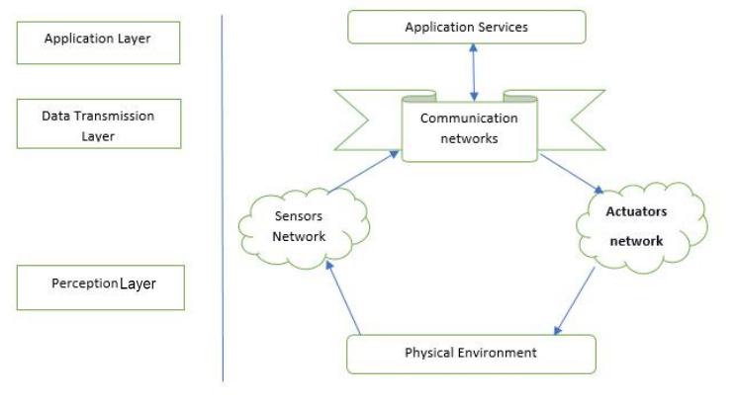
What are Cyber-Physical Systems?
Cyber-Physical Systems are defined as interconnected systems or networks which deals with physical outputs and inputs in real-time and are also called CPS.
Some examples are smart grid, autonomous automobile systems, medical monitoring, industrial control systems.
Architecture of CPS is shown in the image.

Slide 3
Classification of Threats on CPS.
There can be two types of threats Physical and Cyber threats.
Physical threats: Threats that lead to physical damage to devices in a facility or outdoor devices of the CPS.
Some common Physical threats are Use of injected media, Abuse of privilege, physical damage, Stalking, Fake identity and social engineering, CCTV camera interception, Key Hijacking, Physical Breach and any other possible way which cause physical damage to the cyber-physical system can be considered as physical threats.

Slide 4
Classification of Threats on CPS
Cyber Threats: Large infrastructure and use of multiple devices and different technologies CPS also become vulnerable to several cyber threats/cyber attacks on each architectural layer of the system.
Perception Layer attacks/Physical Layer:
Information disclosure and tracking Differential analysis, energy-exhaustion attacks, deception attacks, robust pole-dynamic attacks, covert and attacks, robust attacks.
Network attacks Actuator Enablement attacks (AE-attacks), Actuator Disablement attacks (AD-attacks), Sensor Erasure attacks (SE-attacks), and Sensor Insertion attacks (SI-attacks), node-based attacks nodes capturing. False node, node outage path-based DOS.

Slide 5
Continue Cyber Threats
Data transmission layer attacks: This layer is used for data transmission between the perception layer and application layer, so it is vulnerable to any attack possible to OSI/TCP network layer.
Some common possible attacks are MIMT(Man in Middle Attack), traffic analysis using packet monitoring tools, black hole, flooding of packets cause DOS/DDOS, trap doors, sinkhole, direction misleading sinkholes, wormholes, wrong path selection, tunnelling and illegal access, routing loops, jamming wireless using jammers.

Slide 6
Continue Cyber Threats
Application Layer attacks: On this layer possible attack depends on the technology and environment used such as web application and android etc.
Some common attacks on this layer are web application attacks like SQL or MySQL injection, script insertion attacks like Cross-site scripting (XSS) to get user cookies, malicious code insertion,
Common attacks like buffer and stack overflows and malicious code insertion.
Brute force and Social Engineering attacks password cracking using brute force, dictionary or rainbow tables, phishing and eavesdropping (passive or active).

Slide 7
Countermeasures against attacks
Perception layer: Device data verification using certificates and Encryption, access control, environment monitoring, protective data sharing for the sensor.
Data Transmission Layer: Use things like robust routing protocols, Intrusion detection systems(IDS) and Firewalls, network access control, hop by hop data encryption and authentication and key agreement on the heterogeneous network.
Application Layer: Use end to end encryption, p2p connection, proper authentication and authorization, application-based IDS and firewalls and regular updates of third party extensions.

Slide 8
References
[1] L. Cao, X. Jiang, Y. Zhao, S. Wang, D. You and X. Xu, "A Survey of Network Attacks on Cyber-Physical Systems," in IEEE Access, vol. 8, pp. 44219-44227, 2020, doi: 10.1109/ACCESS.2020.2977423.
[2] Yosef Ashibani, Qusay H. Mahmoud,"Cyber physical systems security: Analysis, challenges and solutions", in Science Direct (ELSEVIER), vol. 68, pp. 81-97, 2017
[3] Jean-Paul A. Yaacoub, Ola Salman, Hassan N. Noura, Nesrine Kaaniche, Ali Chehab, Mohamad Malli, "Cyber-physical systems security: Limitations, issues and future trends", in Science Direct(ELSEVIER), vol. 77, pp. 103201, 2020
[4]Derui Ding, Qing-Long Han, Yang Xiang, Xiaohua Ge, Xian-Ming Zhang,"A survey on security control and attack detection for industrial cyber-physical systems", vol. 275, pp. 1674-1683, 2018

